Slide 1


Evolve 5.1
Units 1-6
Cue cards practice

Slide 2
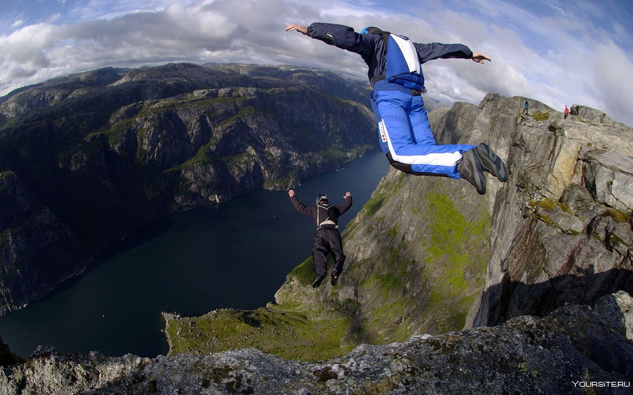


You are going to discuss a topic. Look at the pictures – there are some ideas to help you. You may also use your own ideas.
Discuss with your partners the situations when the changes in life are necessary, how people usually react to them, especially to ones which are outside their control and why.
Use grammar to describe present habits. You have 30 seconds to think.
Now discuss. You have three minutes.
2. Now you have two minutes to decide on two most important changes people face in their lives and the rules which may be helpful to overcome them.
Unit 1.1

Slide 3
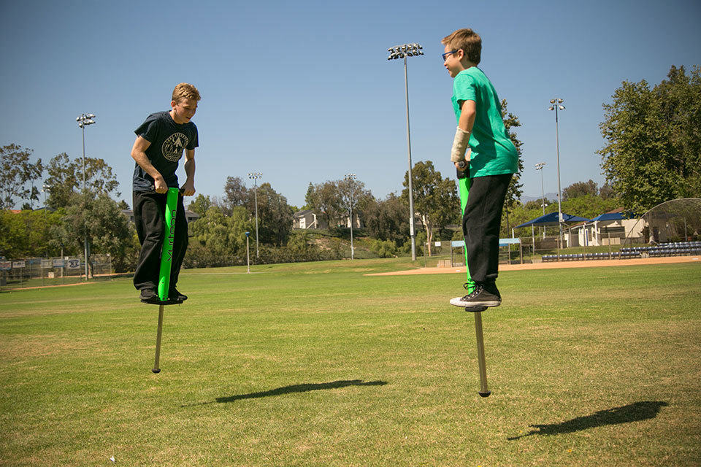
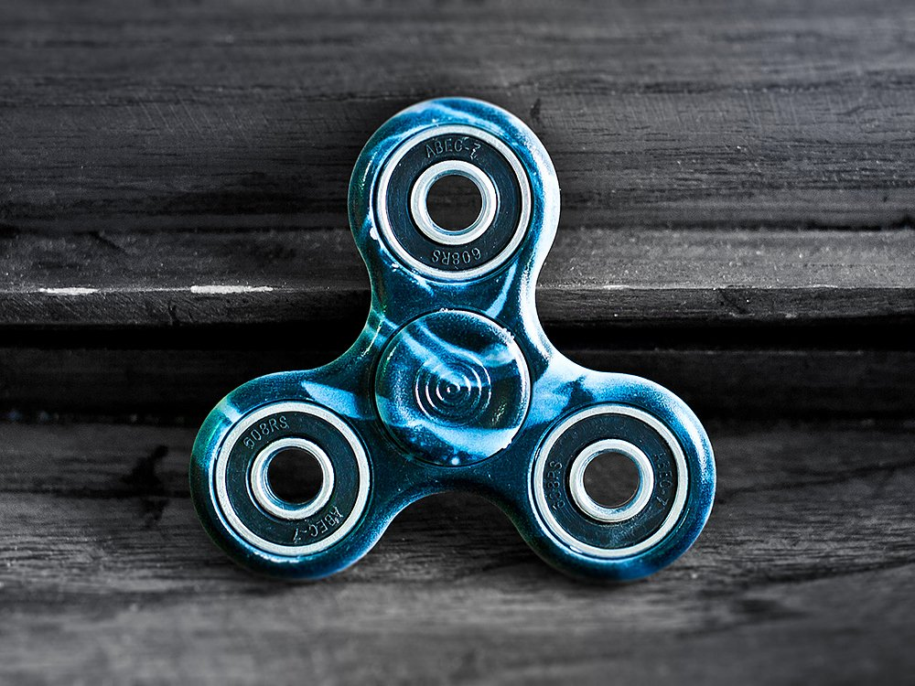
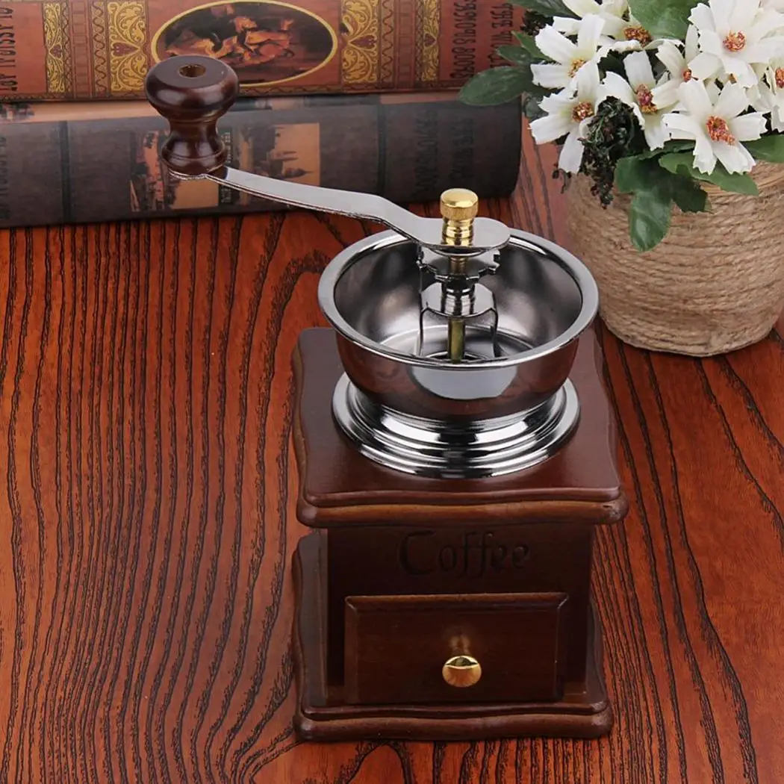
You are going to discuss a topic. Look at the pictures – there are some ideas to help you. You may also use your own ideas.
1. Discuss with your partners the objects from the past which annoyed you. Are they still around? If so, how different are they now?
Use grammar to describe past habits. You have 30 seconds to think.
Now discuss. You have three minutes.
2. Now you have two minutes to decide on two most important material objects in your life. Why are they so important? How did you learn to use them?
Unit 1.2

Slide 4
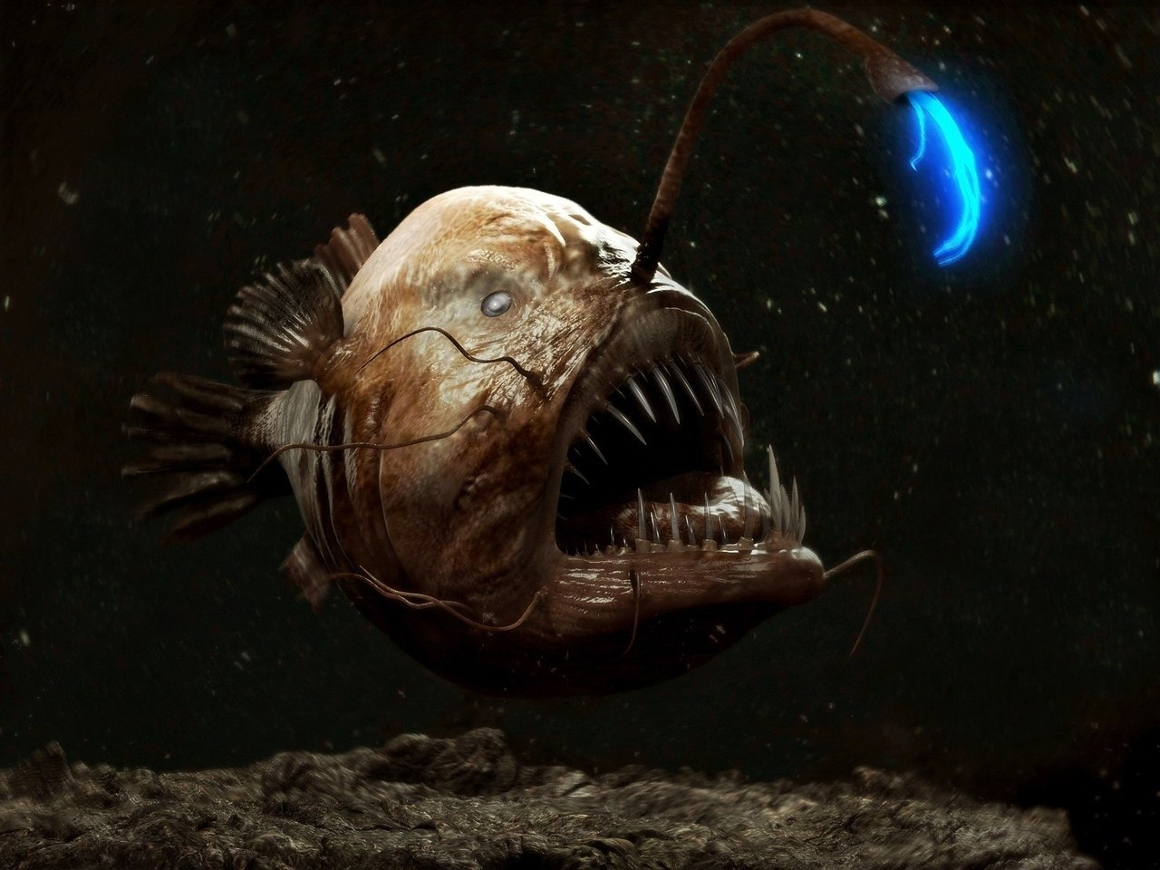
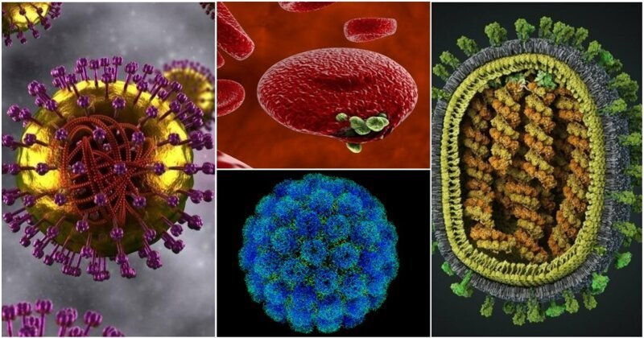
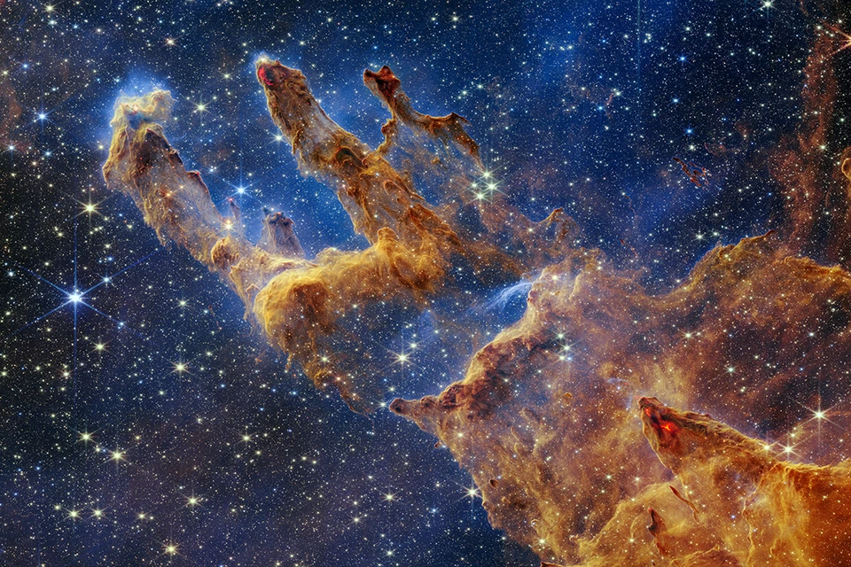
You are going to discuss a topic. Look at the pictures – there are some ideas to help you. You may also use your own ideas.
1. Discuss with your partners the main things scientists explore on our planet and in space. How important are they?
Use comparative structures. You have 30 seconds to think.
Now discuss. You have three minutes.
2. Now you have two minutes to decide on two main areas of research which can be extremely beneficial for humans.
Unit 2.1

Slide 5
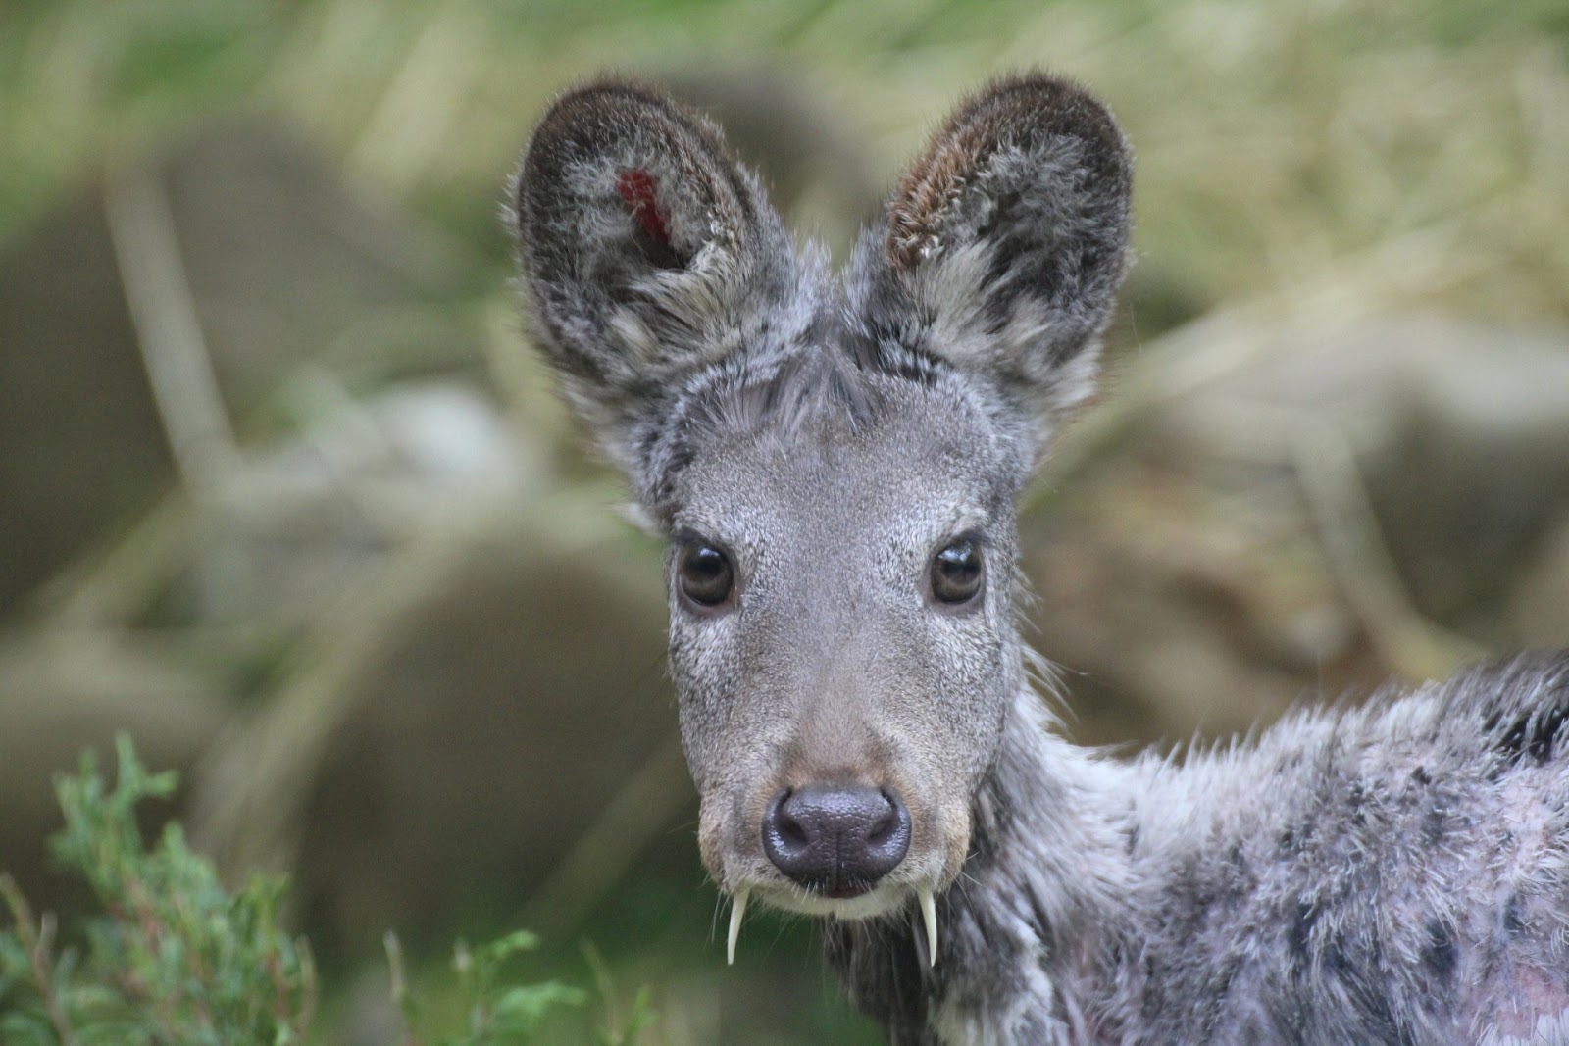
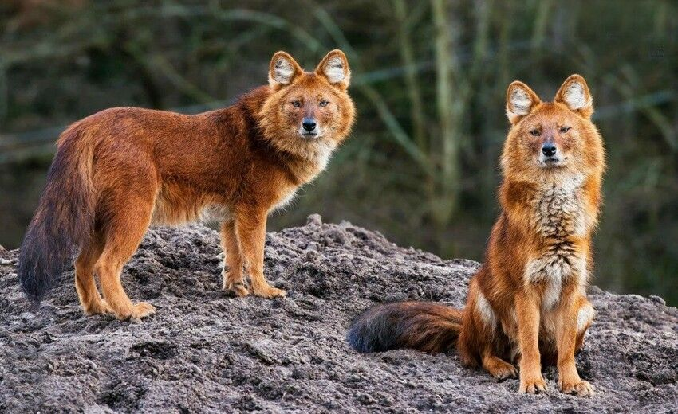
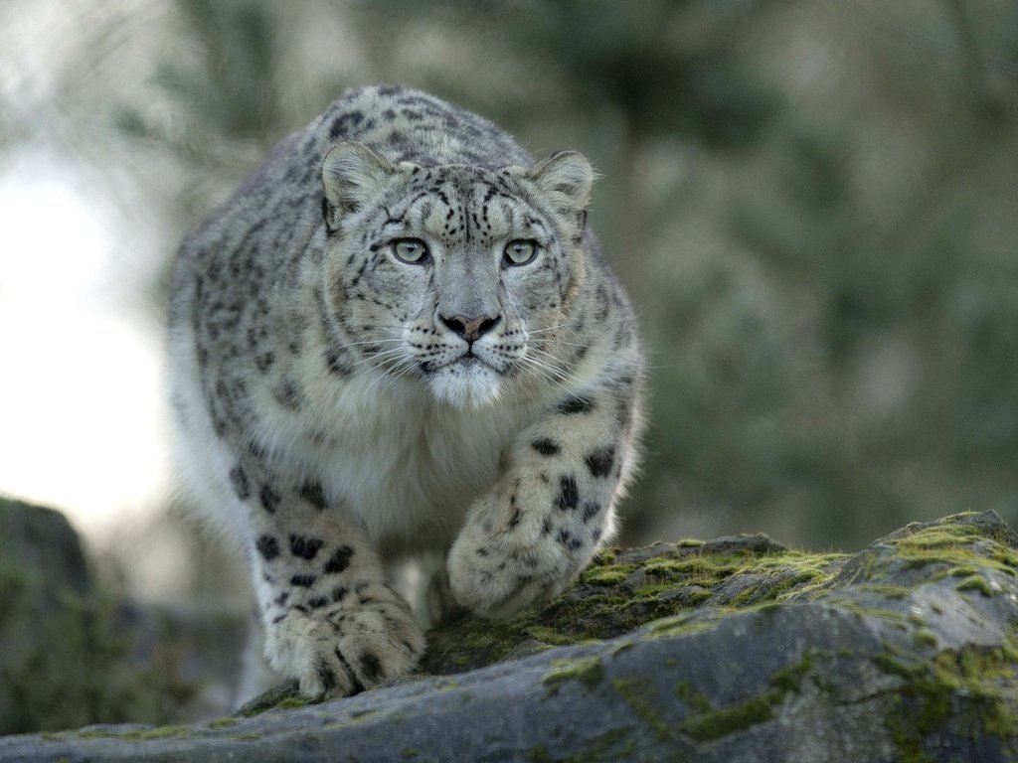
You are going to discuss a topic. Look at the pictures – there are some ideas to help you. You may also use your own ideas.
1. Discuss with your partners the most endangered animals. How difficult is life for them today?
Use superlative structures and ungradable adjectives. You have 30 seconds to think.
Now discuss. You have three minutes.
2. Now you have two minutes to decide on two main steps people can take to protect animals and the reasons why we need to do it.
Unit 2.2

Slide 6
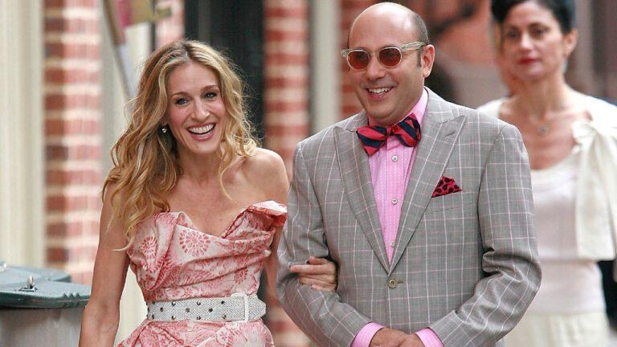
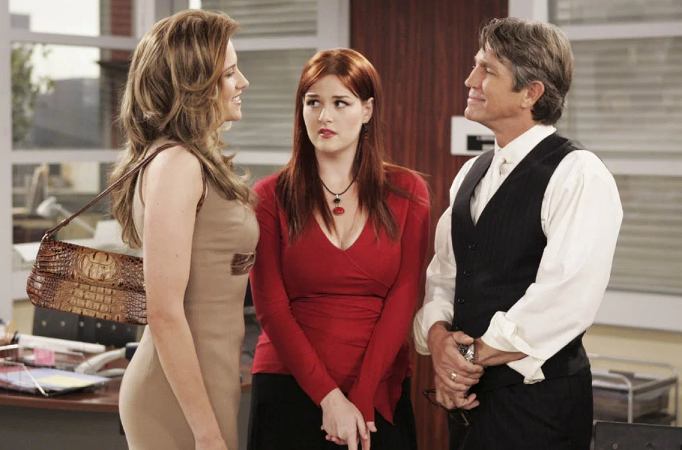
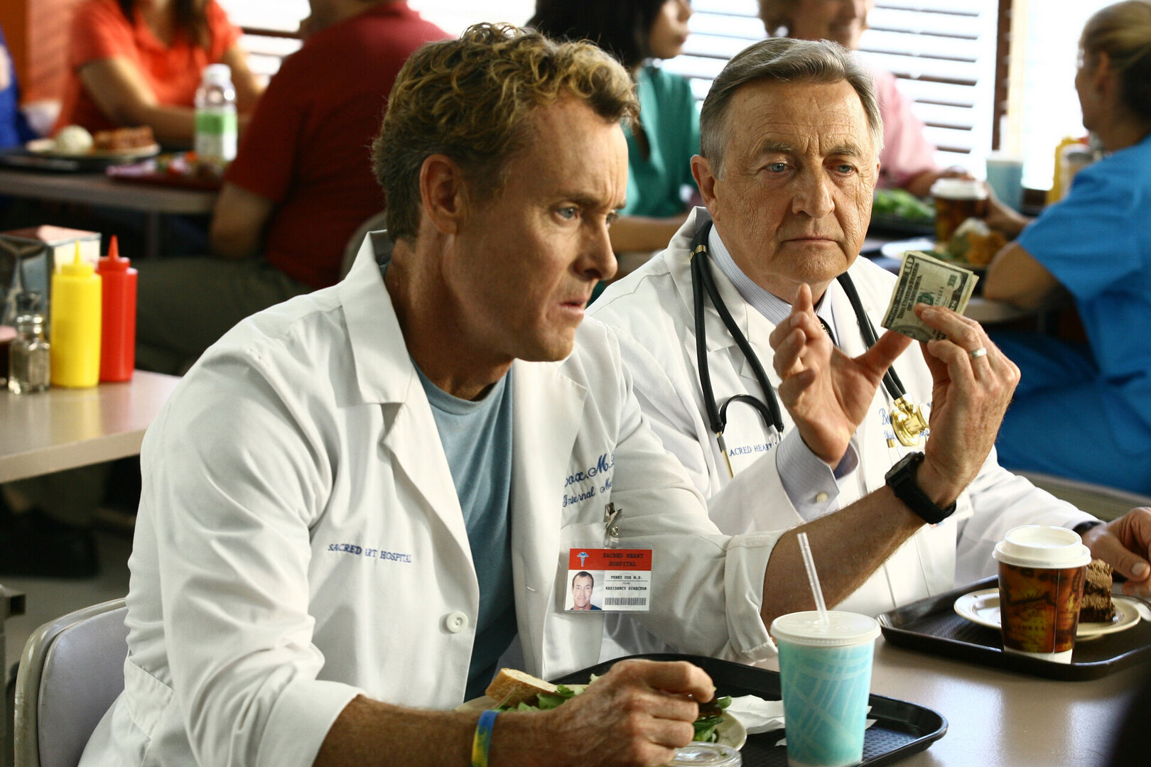
You are going to discuss a topic. Look at the pictures – there are some ideas to help you. You may also use your own ideas.
1. Discuss with your partners what human character types you meet most and what difficulties they may have in communication with the people around.
Use relative pronouns and reduced relative clauses. You have 30 seconds to think.
Now discuss. You have three minutes.
2. Now you have two minutes to decide on two ways which may make the life of both extraverts and introverts easier in dealing with the others.
Unit 3.1

Slide 7
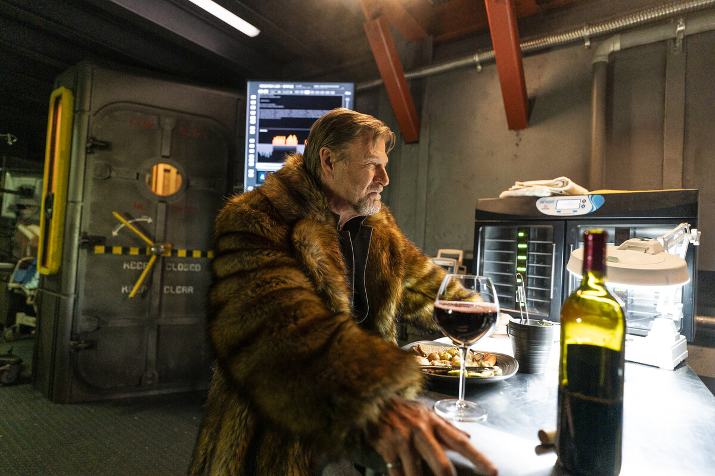
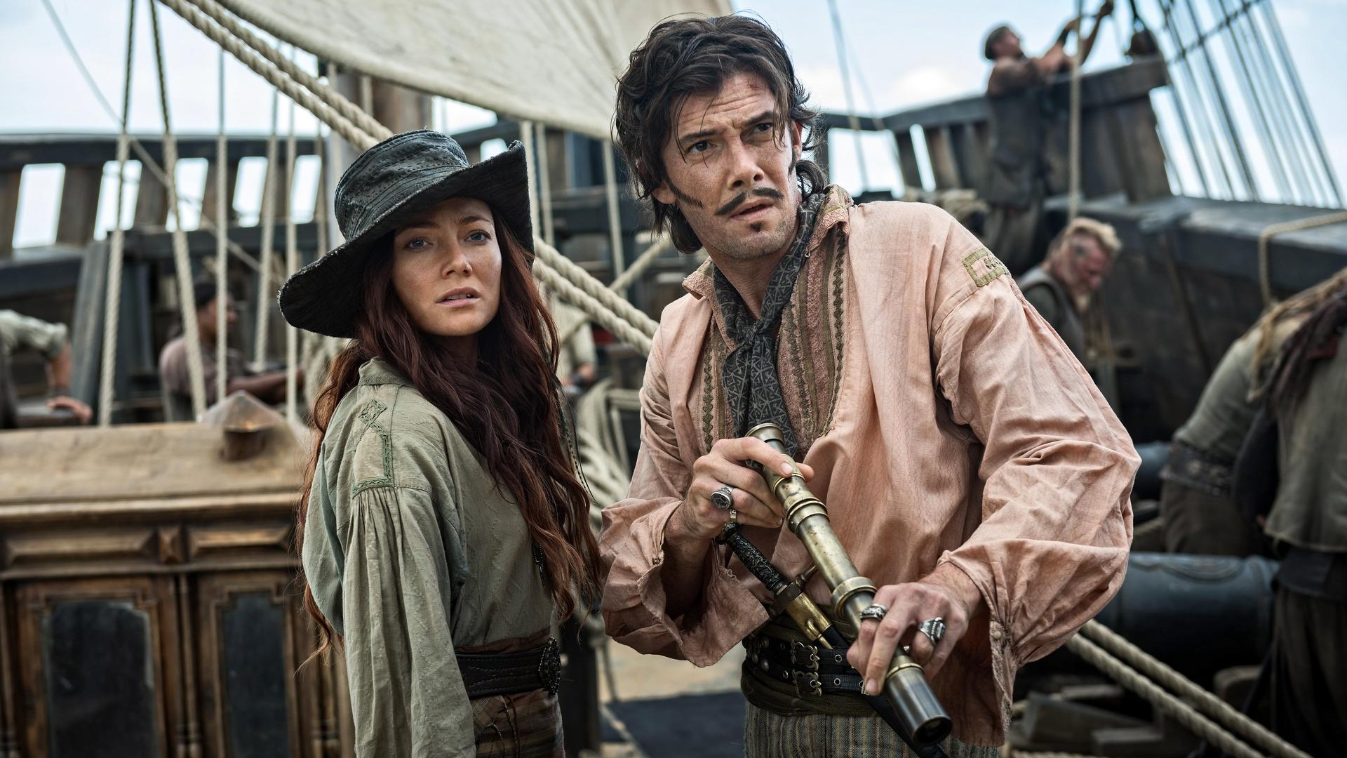
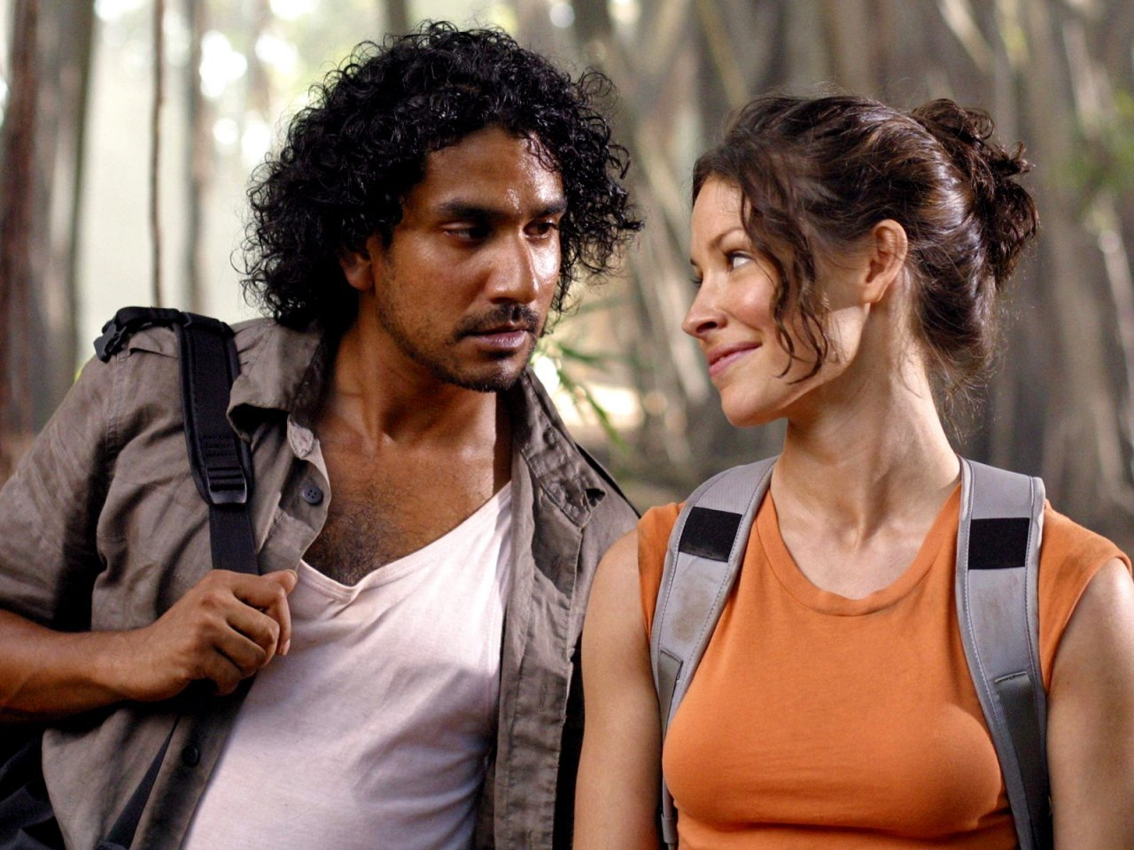
You are going to discuss a topic. Look at the pictures – there are some ideas to help you. You may also use your own ideas.
1. Discuss with your partners some strong feelings people experience and the situations when they have them.
Use present participles. You have 30 seconds to think.
Now discuss. You have three minutes.
2. Now you have two minutes to decide which two main emotions can change our life.
Unit 3.2

Slide 8

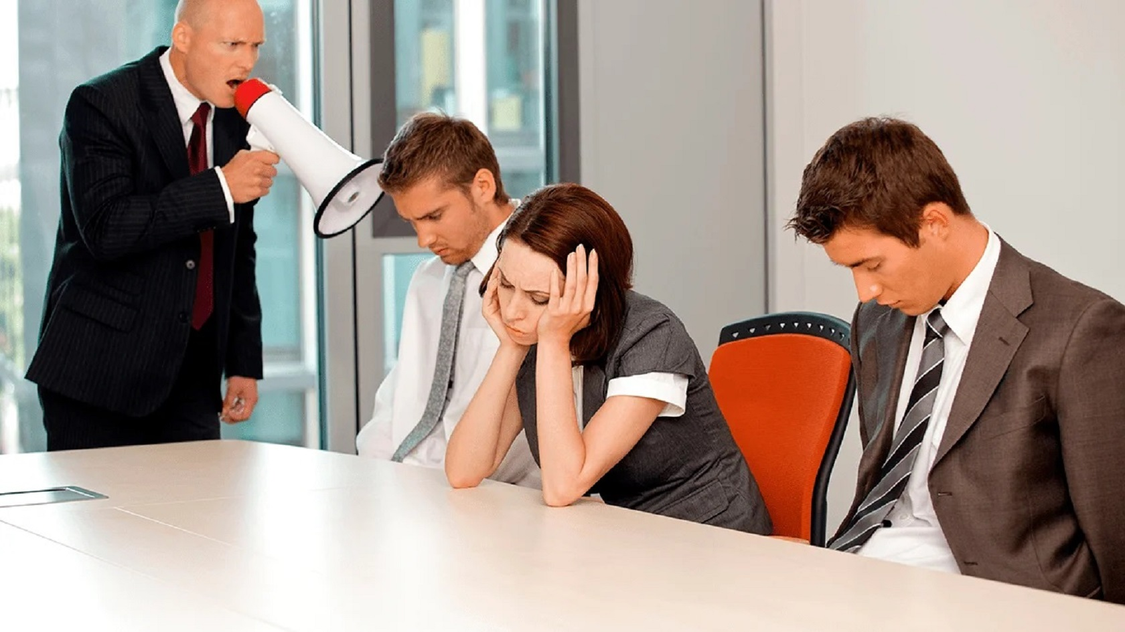

You are going to discuss a topic. Look at the pictures – there are some ideas to help you. You may also use your own ideas.
1. Discuss with your partners what situations reveal the personality types people have. How productive are they to work or to spend time with? Can they do more harm than good sometimes? When?
Use grammar to add emphasis. You have 30 seconds to think.
Now discuss. You have three minutes.
2. Now you have two minutes to decide which two things may be the most effective to do when coordinating a work group of different personalities.
Unit 4.1

Slide 9



You are going to discuss a topic. Look at the pictures – there are some ideas to help you. You may also use your own ideas.
1. Discuss with your partners in what situations red teams may be especially useful and how they may change the work result of a group.
Use reflexive pronouns and pronouns with other/another. You have 30 seconds to think.
Now discuss. You have three minutes.
2. Now you have two minutes to decide on two best ways to be a good red team member.
Unit 4.2

Slide 10
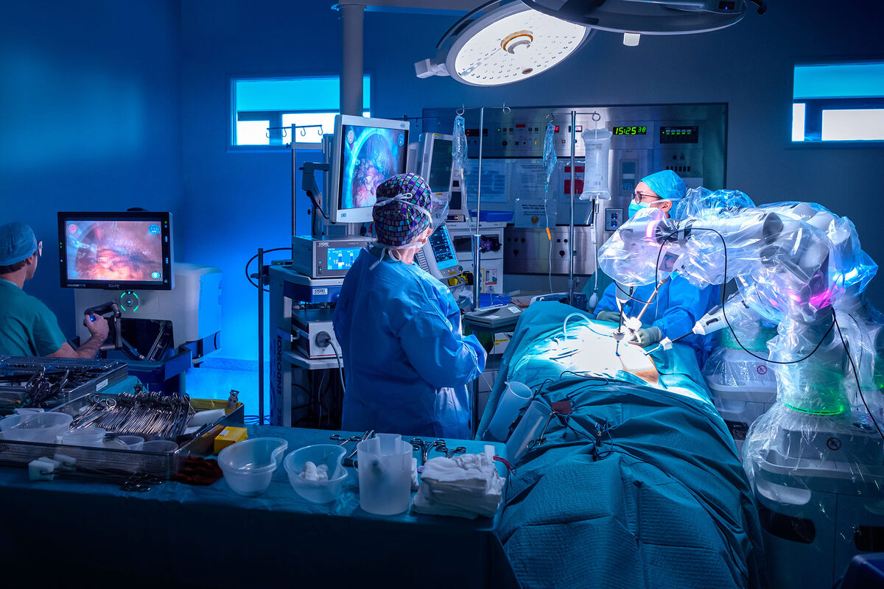
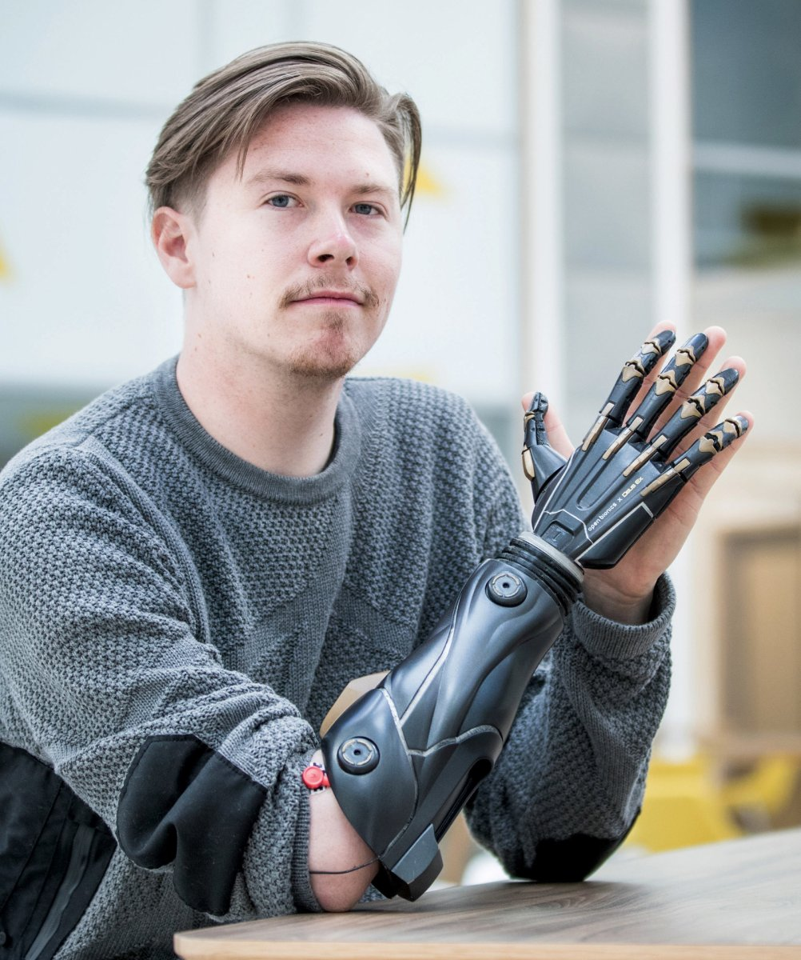

You are going to discuss a topic. Look at the pictures – there are some ideas to help you. You may also use your own ideas.
1. Discuss with your partners which health issues people mostly have and how technologies help them today.
Use real conditionals. You have 30 seconds to think.
Now discuss. You have three minutes.
2. Now you have two minutes to decide which two main benefits VR technology may provide for people in different spheres of their life.
Unit 5.1

Slide 11
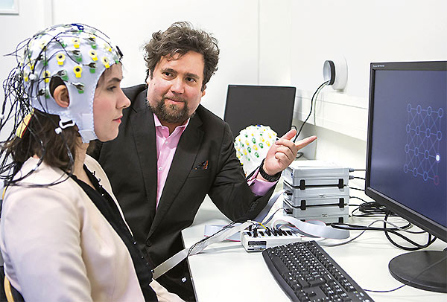
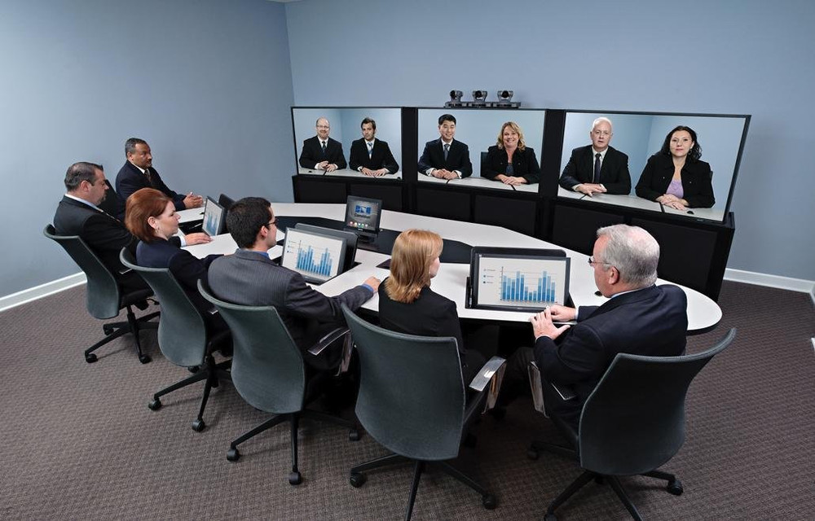
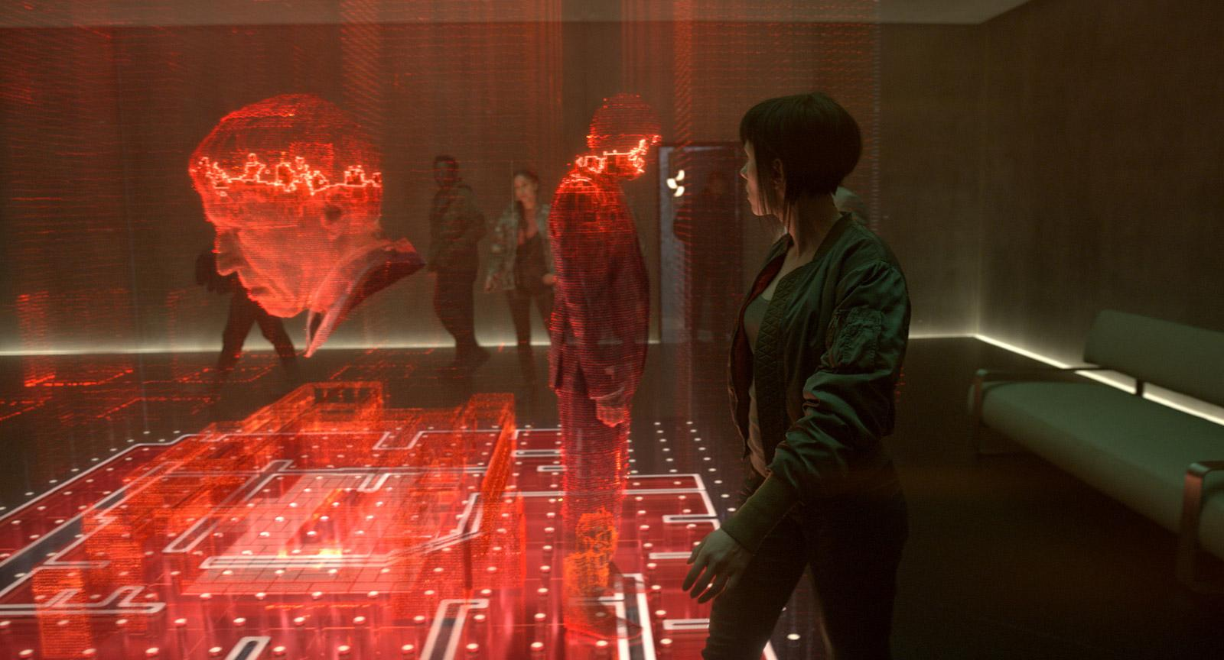
You are going to discuss a topic. Look at the pictures – there are some ideas to help you. You may also use your own ideas.
1. Discuss with your partners how and under what conditions technologies are changing the way we communicate these days.
Use conditionals to express alternatives to if. You have 30 seconds to think.
Now discuss. You have three minutes.
2. Now you have two minutes to decide on two main changes in communication which will take place in the future.
Unit 5.2

Slide 12

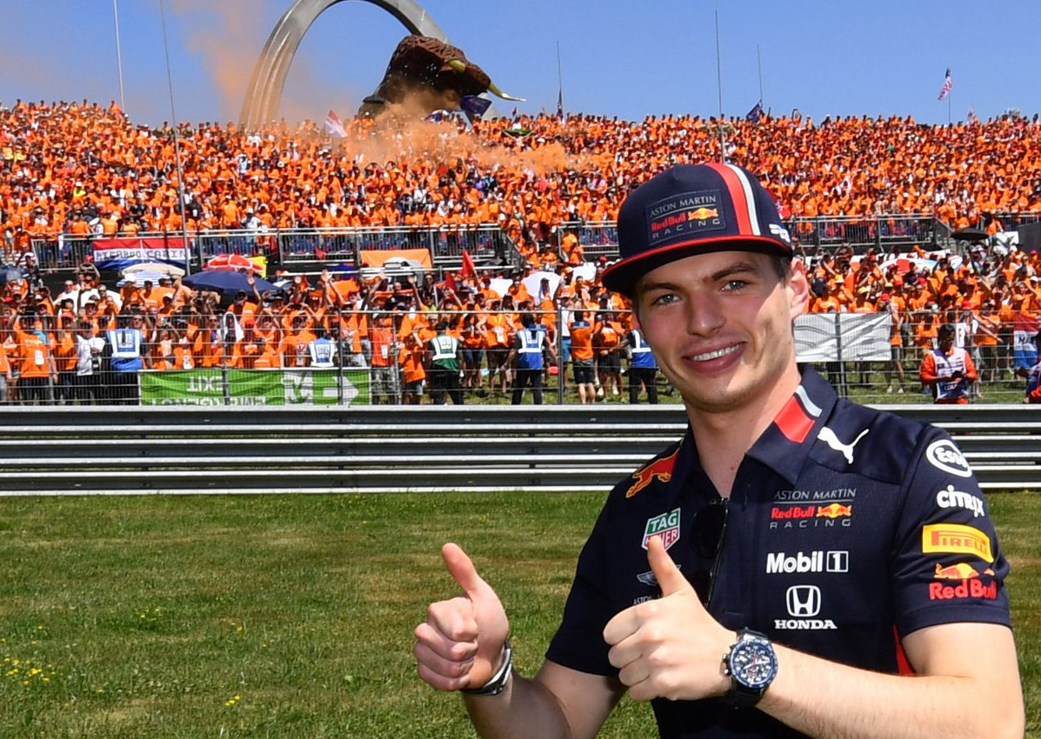
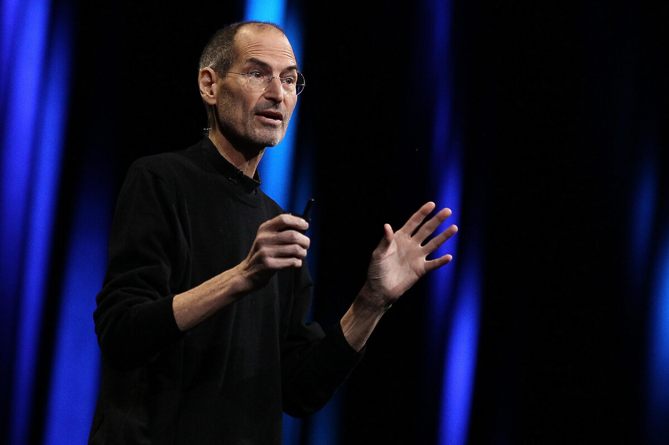
You are going to discuss a topic. Look at the pictures – there are some ideas to help you. You may also use your own ideas.
1. Discuss with your partners your favorite story of a person getting famous and how people mostly become famous today.
Use narrative tenses. You have 30 seconds to think.
Now discuss. You have three minutes.
2. Now you have two minutes to decide on two main reasons to become or not to become famous.
Unit 6.1

Slide 13
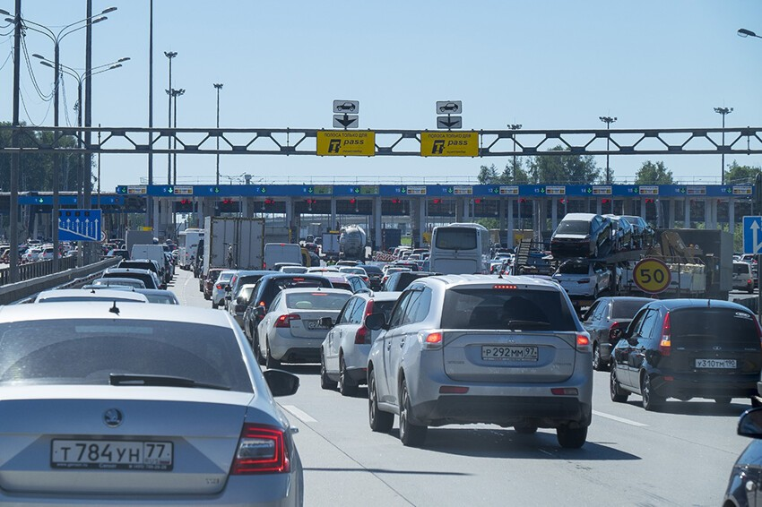
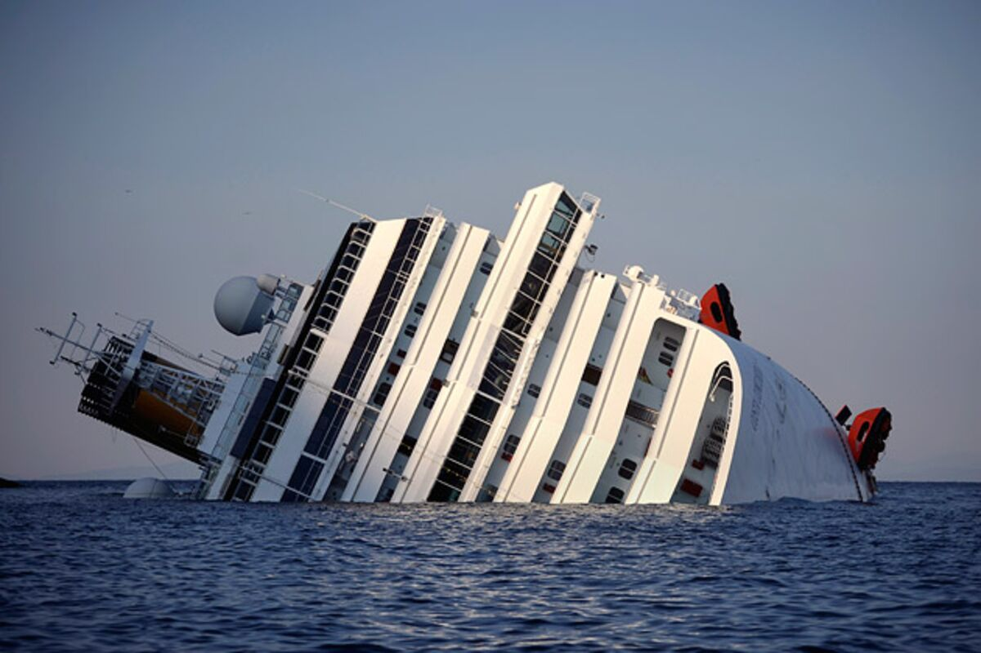
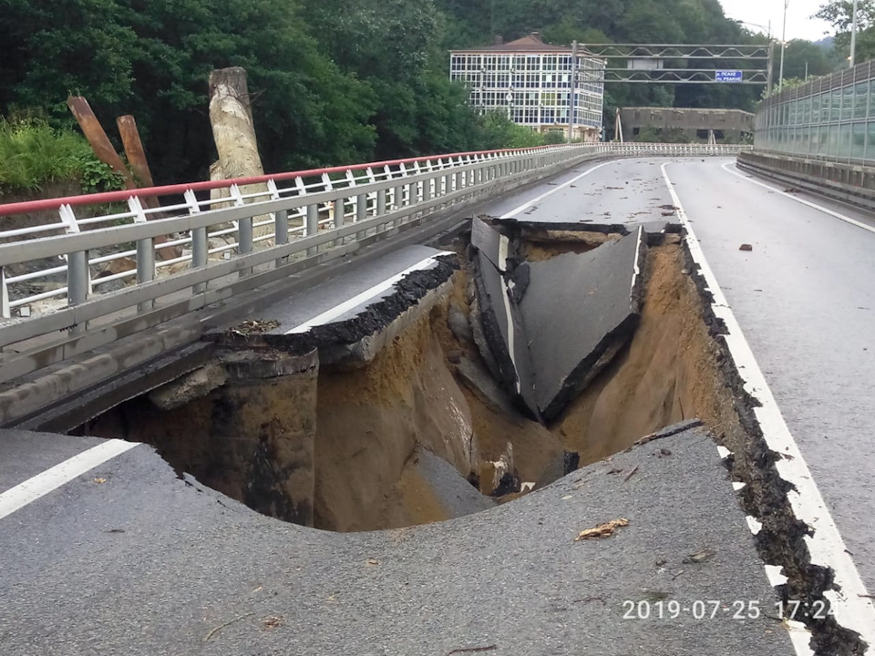
You are going to discuss a topic. Look at the pictures – there are some ideas to help you. You may also use your own ideas.
Discuss with your partners how something went not according to your plan and how you felt about it.
Use reported speech with modal verbs. You have 30 seconds to think.
Now discuss. You have three minutes.
2. Now you have two minutes to decide on two main mistakes people make in managing their expectations.
Unit 6.2

